Slide 1


GUJARAT UNIVERSITY
SCHOOL OF EMERGING SCIENCE AND TECHNOLOGY
Title : Minimizing Energy Generation Cost(EGC Model)
STATEMENT: Create an LP model to minimize energy generation costs while meeting real-time electricity demand, incorporating renewable energy sources and grid constraints.
Moksh Gujar
Sem-6 Data Science
Roll no : DS-09
Enrollment No:202222600022
Shaktisinh Padheriya
Sem-6 Artificial Intelligence
Roll no : AI&ML-15
Enrollment No:202222700013
GUIDED BY:-
Dr. Ankush Suthar Prof. Gautam Chauhan

Slide 2
OBJECTIVES
The primary objective of this study is to develop a Linear Programming (LP) model that minimizes electricity generation costs while ensuring the balance of energy supply and demand.
This model incorporates both renewable and non-renewable energy sources while considering grid capacity constraints.
The goal is to optimize the energy mix, reduce costs, and efficiently meet the real-time electricity demand.

Slide 3
INTRODUCTION
Electricity is essential for daily life, but generating it efficiently while keeping costs low is a major challenge. In many places, both renewable energy sources (like solar and wind) and non-renewable sources (like coal and gas) are used to meet the demand for power.
Non-Renewable Energy is limited in terms of resources , it has high cost and high polluting whereas Renewable Energy is unlimited terms of resources , it has low-cost generation compare to Non- Renewable Energy and it has nearly no polluting.

Slide 4
Renewable energy is environmentally friendly but can be unpredictable, while non-renewable energy is reliable but more expensive and polluting. The goal is to use both types of energy in the best way to keep costs down and still meet the demand for electricity at any given time.
In this presentation, we will show how a Linear Programming (LP) model can help achieve this balance. The model helps minimize the overall cost of energy by determining how much power to generate from each source while meeting the real-time demand and respecting the limits of the power grid.

Slide 5
LITERATURE REVIEW
Owolafe and Akindana (2020) developed an LP model specifically for minimizing total generation costs in thermal power stations, using the Egbin thermal power station in Nigeria as a case study. The study highlighted the effectiveness of piecewise linear approximation to convert non-linear cost functions into a linear format suitable for LP analysis. Results indicated significant reductions in fuel costs while satisfying both generation limits and equality constraints, demonstrating the potential of LP in optimizing traditional energy generation systems.[1]

Slide 6
Dragićević and Bojić (2009) applied LP techniques to minimize total costs associated with steam condensing systems, emphasizing the need for effective economic dispatch models that can accommodate both renewable and non-renewable generation sources. Their findings underscored the necessity of balancing generation costs with operational constraints to ensure efficient energy management across diverse systems.[2]

Slide 7
A study published by Multidisciplinary Digital Publishing Institute (MDPI) discusses the application of LP in constructing mathematical models for optimizing distributed energy systems. This research emphasizes the need for efficient resource allocation among various generation sources, including renewable energy, to enhance overall system performance. The findings suggest that LP can facilitate better decision-making regarding energy distribution and consumption patterns.[3]

Slide 8
The reviewed literature highlights the effectiveness of optimization models such as Linear Programming (LP)in minimizing electricity generation costs while ensuring grid reliability. Research done by Dragićević and Bojić (2009) shows the importance of economic dispatch models in balancing renewable and non-renewable energy sources to achieve cost efficiency. Similarly, study from MDPI emphasize the role of LP in optimizing distributed energy systems, improving resource allocation, and enhancing decision-making in energy management.

Slide 9
Overall, these findings support the integration of optimization techniques such as Linear Programming(LP) to enhance the efficiency, sustainability, and economic feasibility of modern power systems. The insights gained from past research form a strong foundation for developing improved models that incorporate real-time demand, grid constraints, and renewable energy integration.

Slide 10
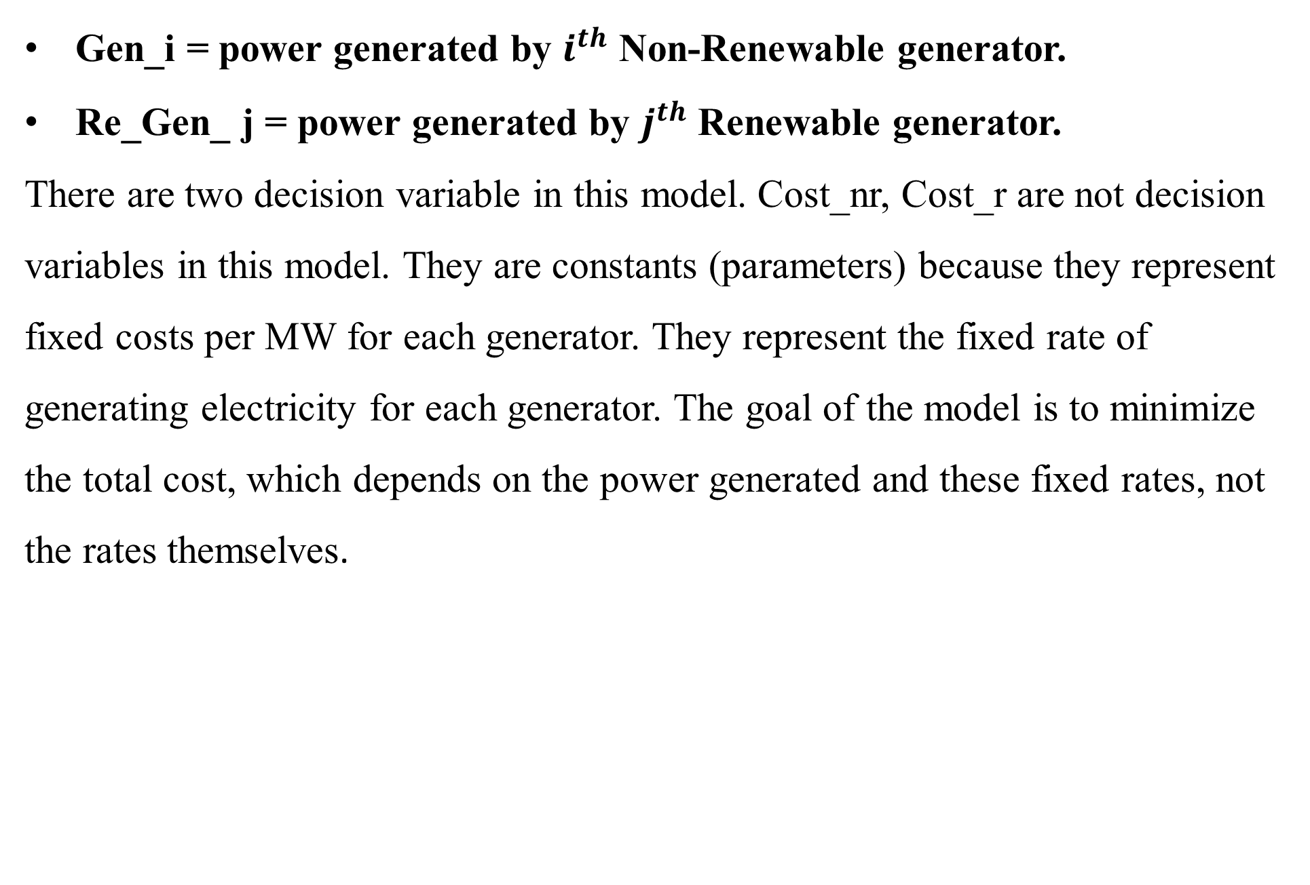
METHODOLOGY
DECISION VARIABLES
Gen_i = power generated by $i^{th}$ Non-Renewable generator.
Re_Gen_ j = power generated by $j^{th}$ Renewable generator.
There are two decision variable in this model. Cost_nr, Cost_r are not decision variables in this model. They are constants (parameters) because they represent fixed costs per MW for each generator. They represent the fixed rate of
generating electricity for each generator. The goal of the model is to minimize the total cost, which depends on the power generated and these fixed rates, not the rates themselves.

Slide 11

OBJECTIVE FUNCTION
Minimize Z= ($∑$Gen_[i]*cost_nr[i] + $∑$Re_Gen_j*cost_r[j])
where,
i=1,2,3,….n
j=1,2,3,….m
For example:
if i=2 and j=1, Objective function will be,
Z=(Gen_[1]*cost_nr[1] + Gen_[2]*cost_nr[2] + Re_Gen_[1]*cost_r[1])

Slide 12
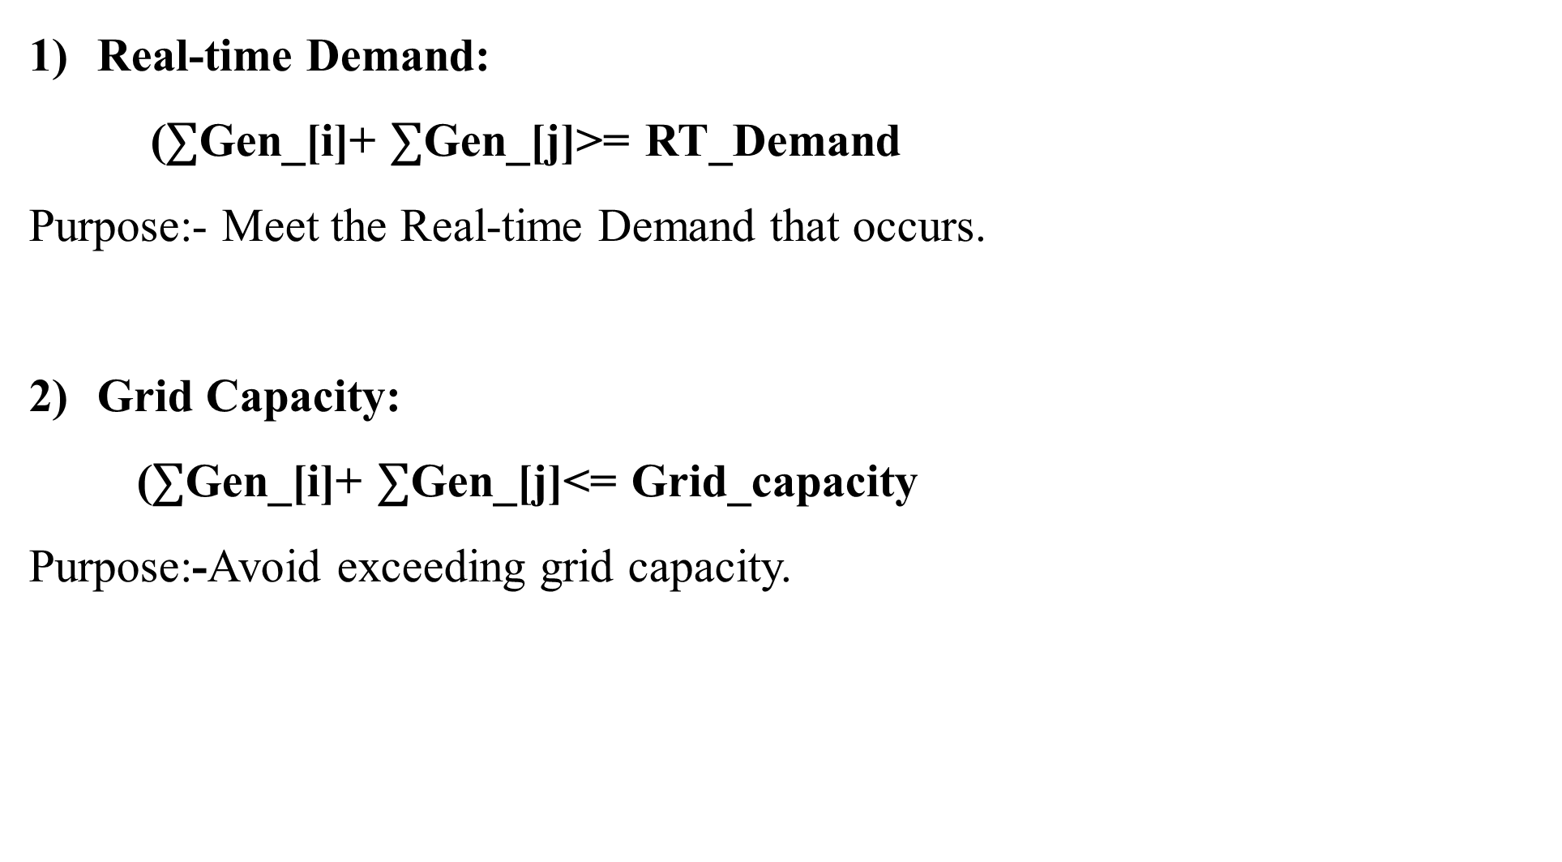
CONSTRAINTS
Real-time Demand:
($∑$Gen_[i]+ $∑$Gen_[j]>= RT_Demand
Purpose:- Meet the Real-time Demand that occurs.
Grid Capacity:
($∑$Gen_[i]+ $∑$Gen_[j]<= Grid_capacity
Purpose:-Avoid exceeding grid capacity.

Slide 13
Individual power constraint of Non-Renewable Generator:
min_p<=Gen[i]<=max_p
Purpose:-Limit non-renewable generators to their operational range.
4) Individual power constraint of Renewable Generator:
min_p<=Gen[j]<=max_p
Purpose:-Limit renewable generators to their operational range.

Slide 14
DATA COLLECTION
1. User-Provided Data (Manual Input via GUI)
Users enter key parameters related to power generation and grid demand.
A. Generator Specifications:-
1) Non-Renewable Generators
Number of non-renewable generators (N)
Minimum power output per generator (MW)
Maximum power output per generator (MW)
Cost per MW generated ($/MW)

Slide 15
2) Renewable Generators
Number of renewable generators (M)
Maximum power output per generator (MW)
Cost per MW generated ($/MW)
B. Grid & Demand Constraints
Real-Time Demand (MW) -The total power needed at a given time.
Grid Capacity (MW) -The maximum power that can be supplied to the grid.

Slide 16
2. System Constraints (Derived Data)
Some constraints are derived from user inputs to ensure model feasibility.
Minimum and maximum power limits ensure that the solution is within the operational range.
Total generation capacity is compared with real-time demand to check feasibility.
Cost constraints ensure that the optimization minimizes cost while meeting demand.

Slide 17
3. Data Processing & Validation
Before running the optimization model, all input data is checked for missing values (e.g., all generator details must be entered).
Validated for correctness (e.g., min power ≤ max power).
Checked against constraints (e.g., demand ≤ grid capacity).

Slide 18
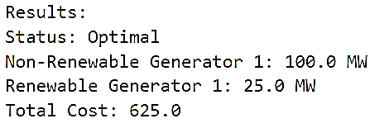
OUTPUT
The results are displayed in a message box and optionally logged in a text output area in the GUI.
Example:

Slide 19
1. Output Components
A) Solution Status:
1) Optimal :-Solution meets demand at the lowest cost.
2) Infeasible :-Solution cannot meet demand at the lowest cost.
B) Energy Allocation:
Amount of power each generator contributes to meet demand.
C) Total Generation Cost:
Summation of (Power Generated × Cost per MW) across all generators.

Slide 20
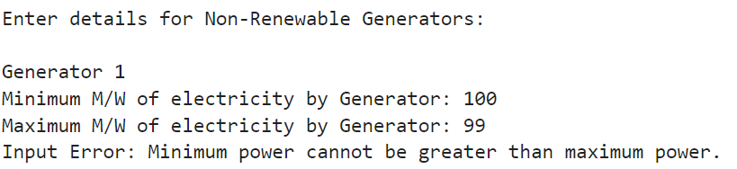

2. Error Handling
if an error arises (invalid inputs, infeasible solutions), error messages are displayed as :

Slide 21
MODEL WORKFLOW
User Input
Data Validation
Optimization Setup
Solve LP Model
Display Results
User Adjustments(if needed)

Slide 22
CONCLUSION
The developed Energy Generation Cost(EGC) Model optimizes energy generation cost while meeting real-time and grid capacity constraints. By using LP techniques, the model effectively balances between renewable and non-renewable energy generation, ensuring both economic efficiency and grid reliability.
The results shows that cost-effective energy allocation can be achieved through systematic allocation of available energy sources which reduces overall expenses while maintaining stability in electric supply.

Slide 23
Additionally, The EGC Model provides a way for user to select different energy generation modes(Renewable, Non-Renewable &Both) and if there is an initial demand, it can also be fulfilled with EGC Model.
Future improvements could focus on real-time demand forecasting, energy storage integration, and adaptive optimization techniques to enhance system performance and further reduce energy costs.

Slide 24
REFERENCES
[1] - https://infonomics-society.org/wp-content/uploads/LP-Model-A-Panacea-to-Electricity-Generation-Cost.pdf
[2] - https://www.semanticscholar.org/paper/Application-of-linear-programming-in-energy-Dragi%C4%87evi%C4%87-Bojic/acb086fdcaf78ddd201b39e6f381576244cc51b1
[3] - https://www.mdpi.com/1996-1073/15/5/1872

